Slide 1


Unity 3D Project
A
Project Report Submitted
in the Partial Fulfillment of the Requirements for the award of
Bachelor of Technology
in
COMPUTER SCIENCE AND ENGINEERING
by
ARCHIT SHARMA(2004480100001)
UDAYBHAN KUMAR(2104480109014)
Under the Guidance of
Prof. Fatima Khan
Department of Computer Science & Engineering
Neelam college of enginnering and technology,
AGRA
to the
DR. A.P.J. ABDUL KALAM TECHNICAL UNIVERSITY LUCKNOW (UP), INDIA

Slide 2
MAY-2023
DECLARATION
I hereby declare that this submission is my own work and that, to the best of my knowledge and belief, it contains no material previously published or written by another person nor material which to a substantial extent has been accepted for the award of any other degree or diploma of the university or other institute of higher learning, except where due acknowledgment has been made in the text.
Signature:
Name: Archit Sharma
Roll no:2004480100001
Signature:
Name: Udaybhan kumar
Roll no:2104480109014

Slide 3
CERTIFICATE
This is to certify that Project Report entitled – Unity 3D Project which is submitted by Udaybhan Kumar(2104480109014) Archit Sharma(20044801000001) in partial fulfilment of the requirement for the award of degree B.Tech. in Department of CSE, of Dr A.P.J. Abdul Kalam Technical University, U.P, Lucknow, is a record of the candidate own work carried out by him/her under my/our supervision. The matter embodied in this Project report is original and has not been submitted for the award of any other degree.
Date:
Project Guide Mrs. Fatima Khan
Agra

Slide 4
Acknowledgment
It gives us a great sense of pleasure to present the report of the B.Tech Project undertaken during B.Tech Final Year. We own special debt of gratitude to our guide Mrs. Fatima Khan Department of CSE, Neelam College of Engineering and Technology, Agra for his constant support and guidance throughout the course of our work. His sincerity, thoroughness and perseverance have been a constant source of inspiration for us. It is only his cognizant efforts that our endeavours have seen light of the day.
We also take the opportunity to acknowledge the contribution of Prof. Fatima Khan, Department of CSE, Neelam College of Engineering and Technology, Agra, for his full support and assistance during the development of the project.
We also do not like to miss the opportunity to acknowledge the contribution of all faculty members of the department for their kind assistance and cooperation during the development of our project. Last but not the least, we acknowledge our friends for their contribution in the completion of the project.
Signatur Name | e : Archit Sharma | Signature: Name : Udaybhan kumar
Roll No. | : 2004480100001 | Roll No.: 2104480109014

Slide 5
TABLE OF CONTENT
Introduction
Project Setup
Scene Setup
Player Controller
Environment interaction
UI Development
Game Mechanics
Polishing and Optimization
Deployment
Conclusion

Slide 6
Introduction
Welcome to "Gun Game: Tactical Warfare", an immersive Unity 3D project designed to provide players with an adrenaline-pumping experience of combat in a dynamic virtual environment. In this game, players are thrust into intense battles where their survival depends on quick reflexes, strategic thinking, and precise marksmanship
Unity is a cross-platform game engine developed by Unity Technologies, first announced and released in June 2005 at Apple Worldwide Developers Conference as a Mac OS X game engine. The engine has since been gradually extended to support a variety of desktop, mobile, console, augmented reality, and virtual reality platforms.
History
The Unity game engine launched in 2005, aiming to "democratize" game development by making it accessible to more developers. It was shown at Worldwide Developers Conference 2005 by Scott For stall on Mac OS X.
Unity 2.0 (2007)
Unity 2.0 launched in 2007 with approximately 50 new features. The release included an optimized terrain engine for detailed 3D environments, real-time dynamic shadows, directional lights and spotlights, video playback, and other features.
Unity 3.0 (2010)
Unity 3.0 launched in September 2010 with features expanding the engine's graphics features for desktop computers and video game consoles. In addition to Android support, Unity 3 featured integration of Illuminate Labs' Beast Light map tool, deferred rendering, a built-in tree editor, native font rendering, automatic UV mapping, and audio filters, among other things.
Unity 4.0 (2012)
In November 2012, Unity Technologies delivered Unity 4.0. This version added DirectX 11and Adobe Flash support, new animation tools called Mechanism, and access to the Linux preview.
Facebook integrated a software development kit for games using the Unity game engine in 2013.
Unity 5 (2015)
The Verge said of 2015's Unity 5 release: "Unity started with the goal of making game development universally accessible. Unity 5 is a long-awaited step towards that future." With Unity 5, the engine improved its lighting and audio. Through Web GL, Unity developers could add their games to compatible Web browsers with no plug-ins required for players.

Slide 7


Annual releases (2017–2023)
In December 2016, Unity Technologies announced that they would change the version numbering system for Unity from sequence-based identifiers to year of release to align the versioning with their more frequent release cadence; Unity 5.6 was therefore followed by Unity 2017. Unity 2017 tools featured a real-time graphics rendering engine, color grading and world building, live operations analytics and performance reporting.
Unity 6 (2024)
On November 16, 2023, Unity announced that the next version of the engine would be called Unity 6, reverting to the previous version numbering convention. Unity 6 is planned for release in 2024, with planned features including new generative AI tools called Unity Muse and Unity Sentries.
2. Project Setup : Gun Game Development
Ensure you have Unity 3D installed on your system. The recommended version is Unity 2020.3 LTS (Long Term Support) or newer for stability and compatibility with the latest features and packages.
Starting Unity for the first time
When you launch the Unity Editor, the Home Screen appears. If you have no existing Unity Projects on your computer, or if this is your first time opening the Unity Editor, the Home Screen displays the Learn tab.
Creating a Project

Slide 8
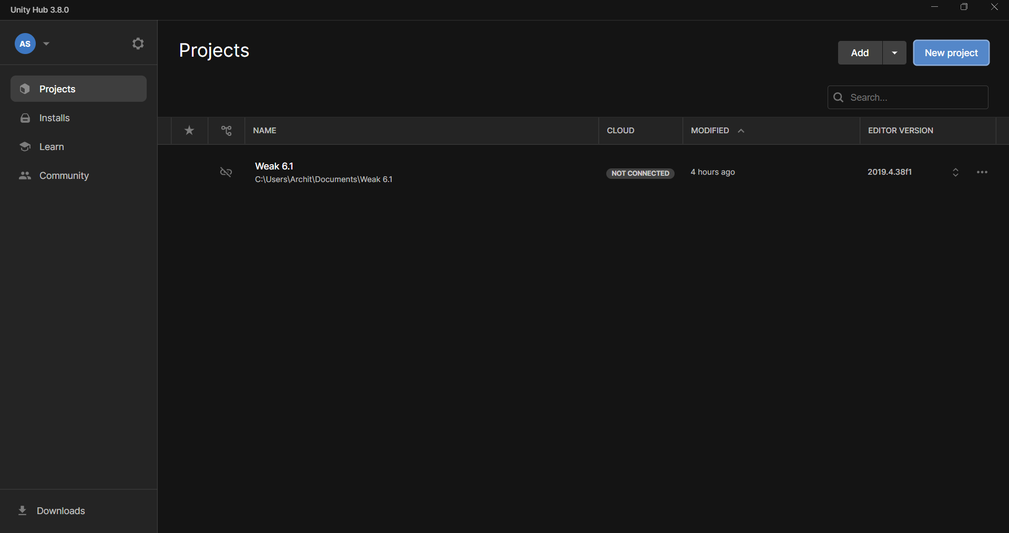
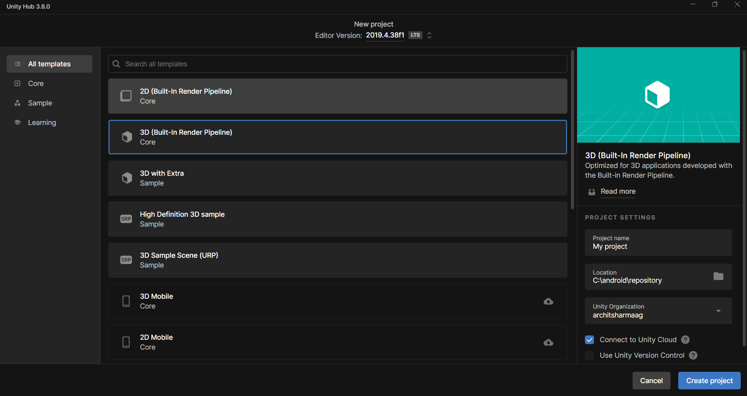
In the top right corner of the Home Screen, click ‘New’ to see the Create Project window.
To access the Home Screen when you are already in the Unity Editor, go to File > New Project ….
From the Create Project window, there are various starter settings for you to apply before Unity creates your project. These are described in detail below

Slide 9
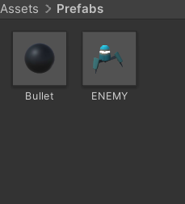
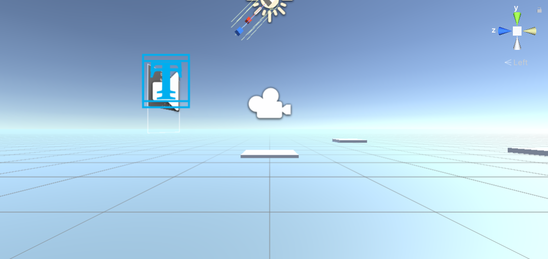
3. Scene Setup for Gun Game Development
1. Terrain Creation:
Create a new terrain by selecting Game Object -> 3D Object -> Terrain.
Use the Terrain Tools to sculpt the terrain to fit your level design, including hills, valleys, and obstacles.
Apply textures and foliage to the terrain to enhance visual appeal and provide cover for players and enemies.
2. Lighting Setup:
Add directional light to simulate sunlight and create shadows in the scene.
Adjust light settings such as intensity, color, and shadows to achieve the desired ambiance.
Utilize additional light sources (point lights, spotlights) to illuminate specific areas or enhance visual effects.

Slide 10
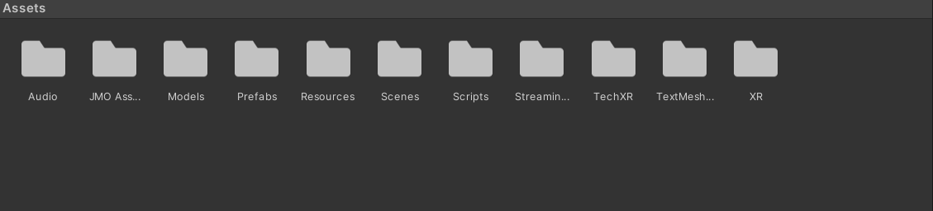
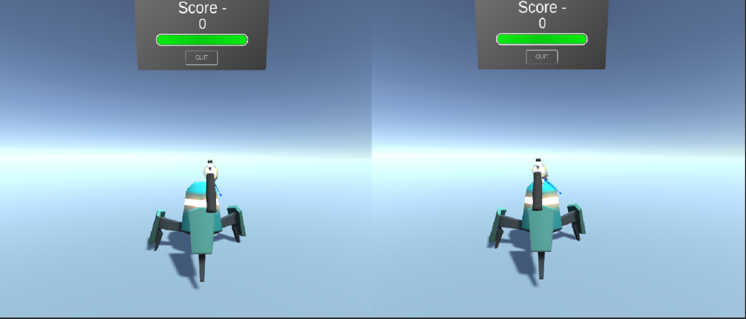
3. Camera Setup:
Create a new camera Game Object to serve as the player's perspective.
Adjust the camera's position, rotation, and field of view to provide optimal visibility and gameplay experience.
Implement camera controls (e.g., mouse or joystick inpu
t) to enable players to move the camera view freely or focus on specific targets.
4. Environment Assets:
Populate the scene with environmental assets such as buildings, foliage, rocks, and other props to create a realistic and immersive setting.
Place interactive objects like doors, switches, or destructible elements to add depth to the gameplay and encourage exploration.
5. Player and Enemy Spawning:

Slide 11

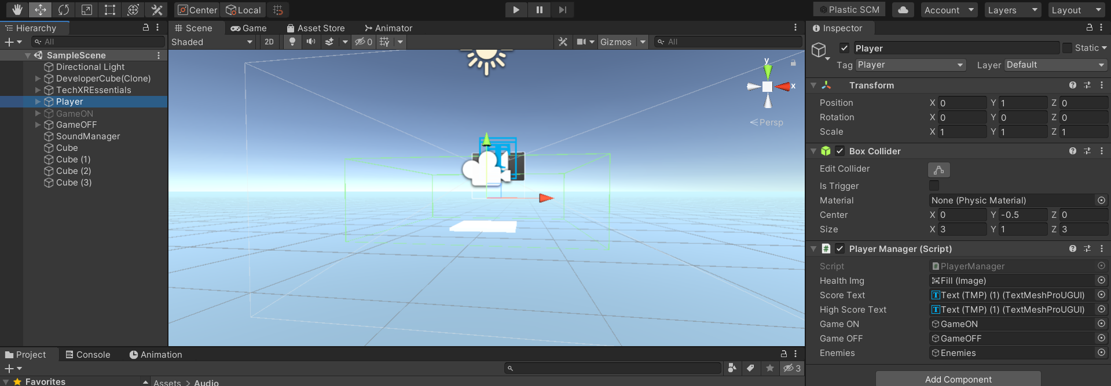
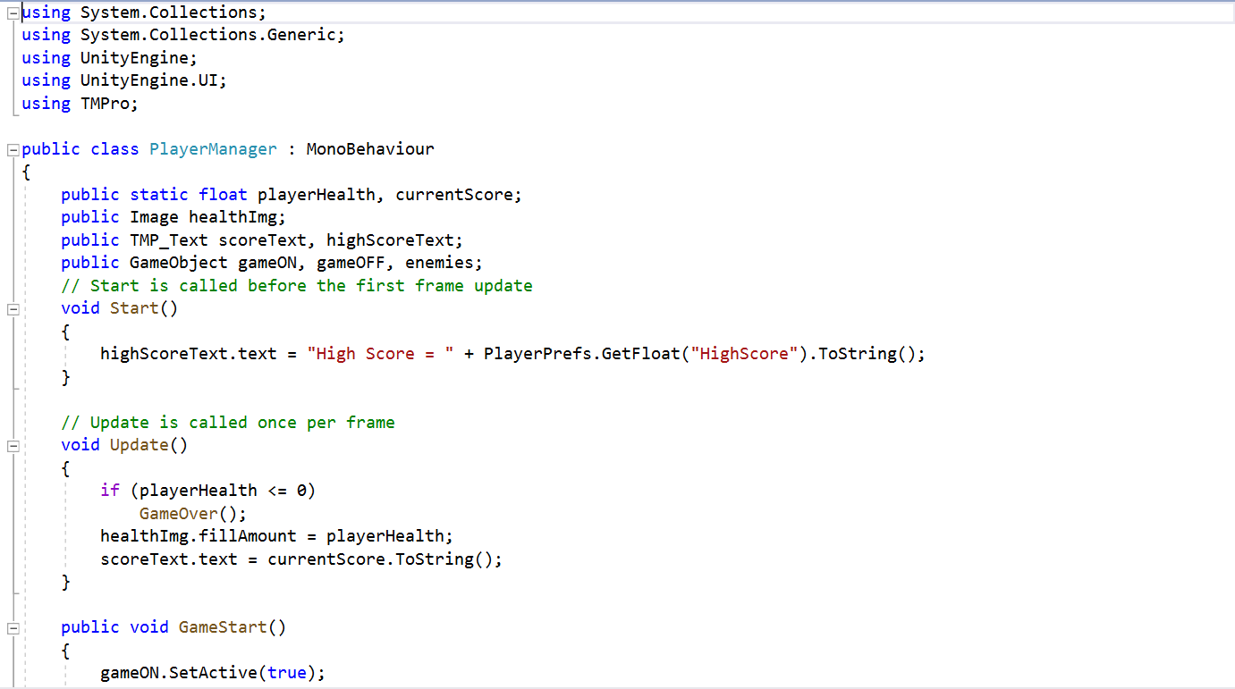
Player Controller Setup:
Character Controller component reference
SWITCH TO SCRIPTING
The Character Controller is mainly used for third-person or first-person player control that does not make use of Rigid body physics.
1. Creating the Player Controller Script:
Open your preferred code editor (e.g., Visual Studio or JetBrains Rider).
Create a new C# script named "Player Controller" or a similar descriptive name.

Slide 12
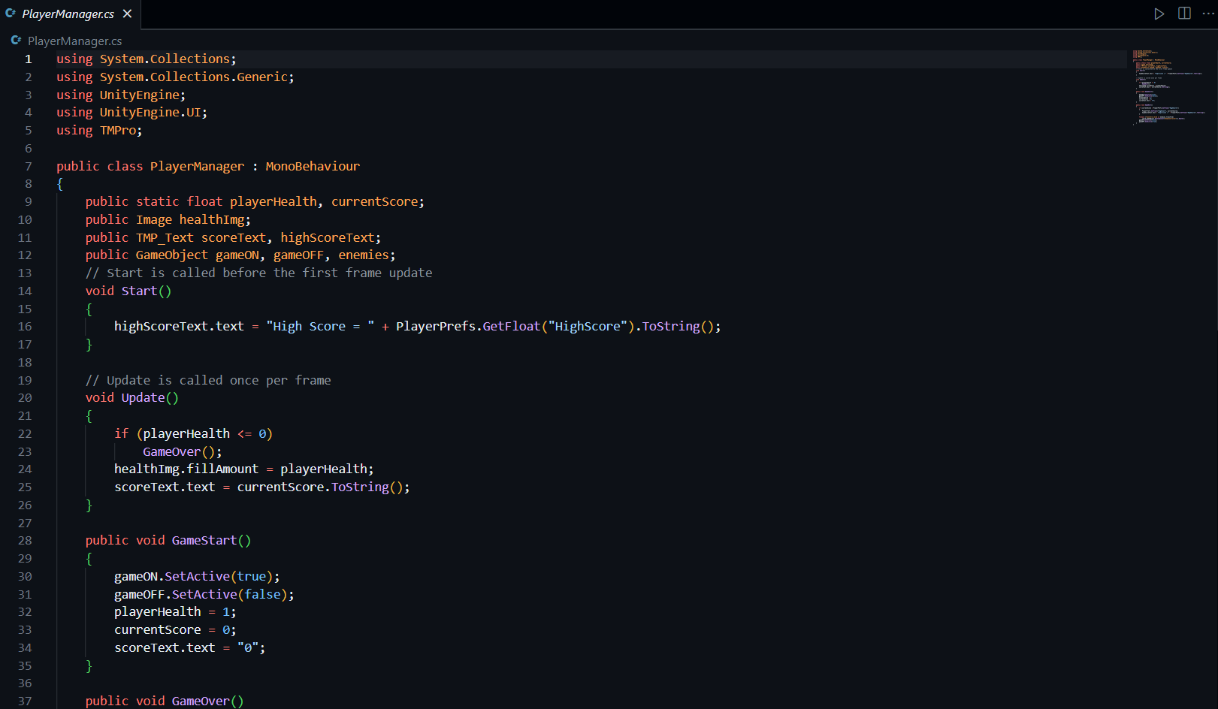
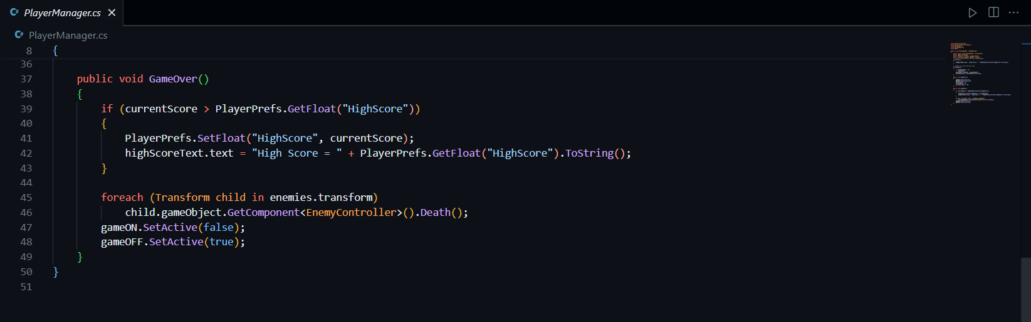
2. Implementing Player Movement and Shooting:
Within the Player Controller script, define variables for player movement speed, jump force, and shooting mechanics.
Use Unity's Input system to capture player input for movement (e.g., WASD keys or joystick) and shooting (e.g., left mouse button or gamepad trigger).
Implement functions to handle player movement, including character rotation, forward/backward movement, strafing, and jumping.
Implement a shooting function to instantiate bullets or projectiles from the player's weapon, applying force or damage to enemies upon collision.

Slide 13
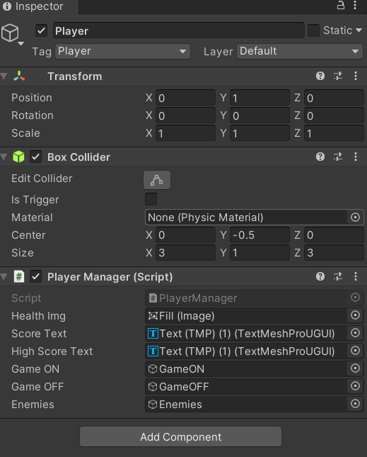
Attaching the Script to the Player Game Object:
UI Development for Gun Game:
1. Creating UI Elements:
HUD (Heads-Up Display): Design elements like health bars, ammo counters, and mini-maps to provide essential information to players during gameplay.

Slide 14
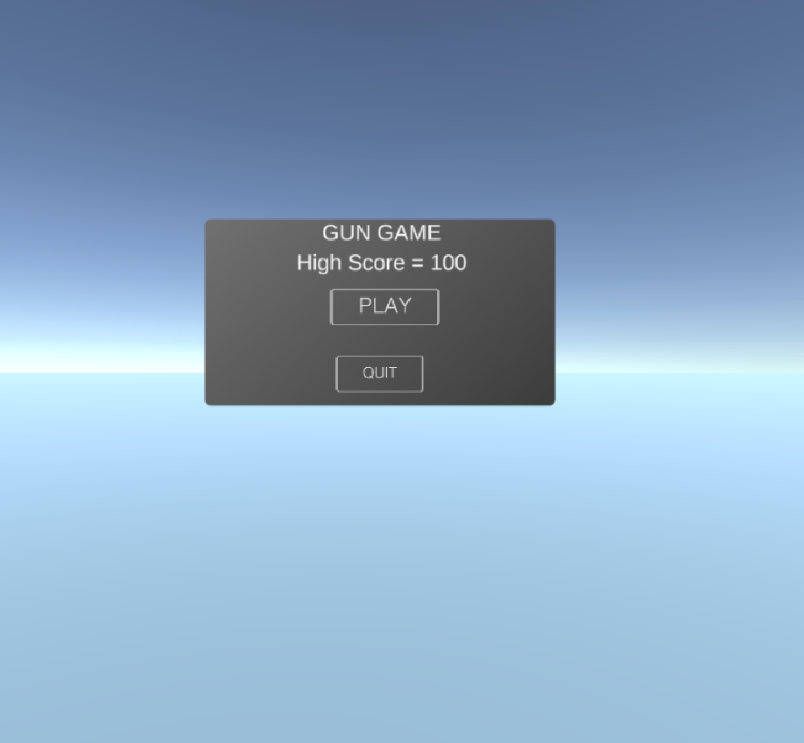
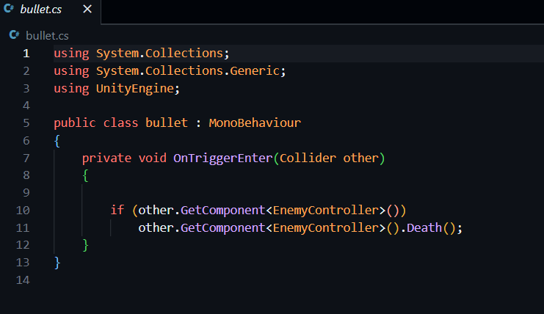
Menus: Create menus such as the main menu, pause menu, settings menu, and game over menu. Include options to start or resume the game, adjust settings, and quit the game

Slide 15

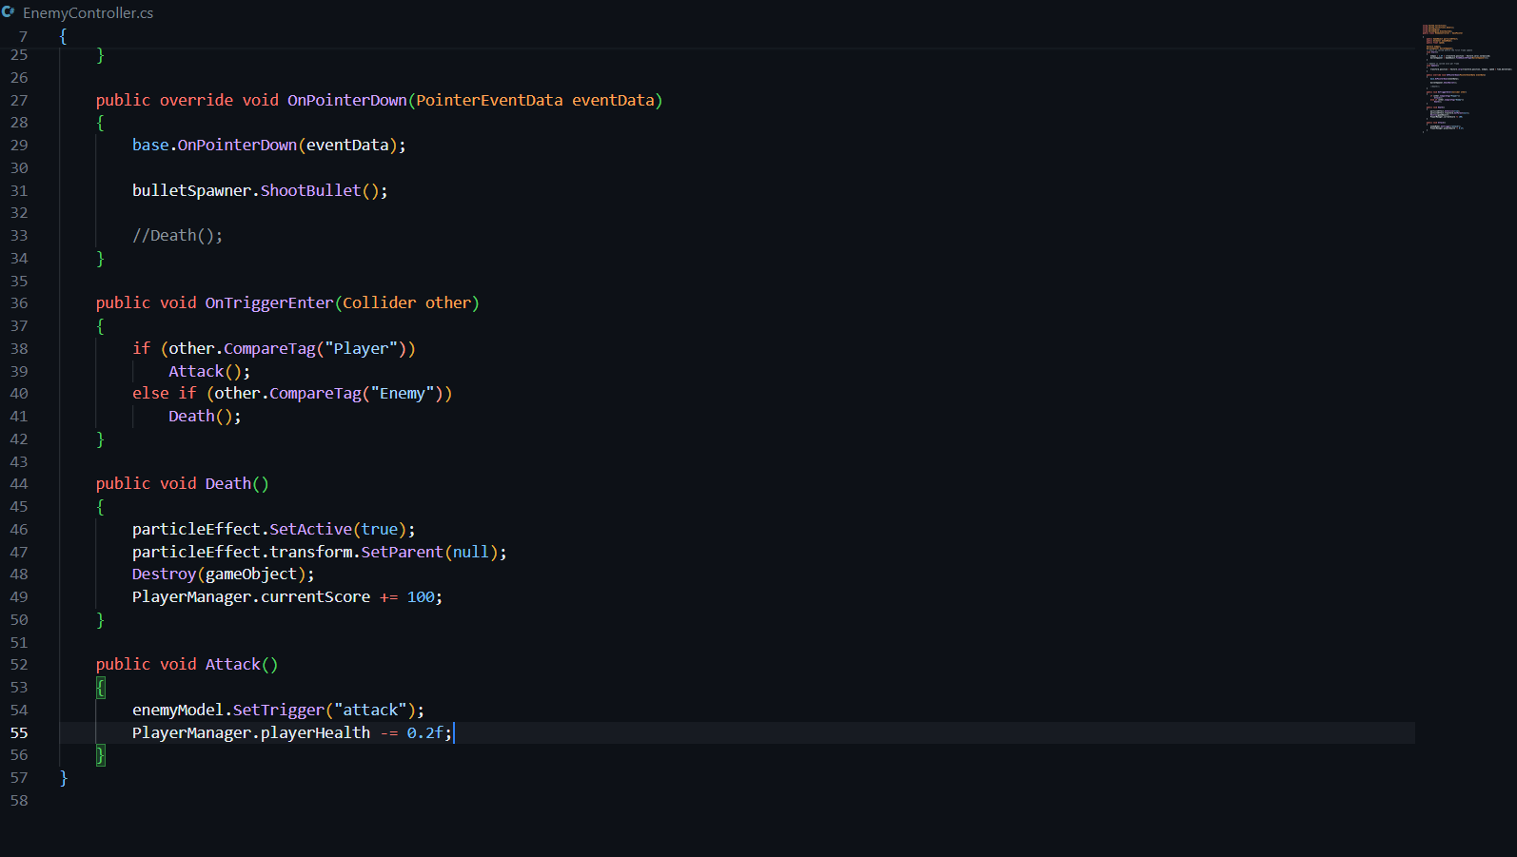
Game Mechanics for Gun Game Development:
1. Scoring System:
Objective: Keep track of the player's performance and provide feedback on their progress.
Implementation Steps:
Create a Score Manager script to manage scoring logic.
Award points for actions such as defeating enemies, completing objectives, or collecting items.
Update the UI to display the player's current score.

Slide 16
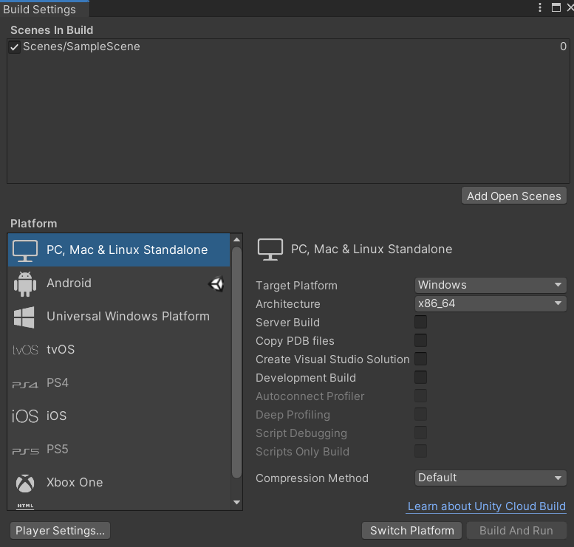
Deployment for Gun Game:
1. Building for Different Platforms:
PC (Windows, mac OS, Linux):
Go to File -> Build Settings in Unity.
Select the target platform (e.g., PC, Mac, Linux) and click "Switch Platform."
Configure build settings (e.g., resolution, graphics quality) and click "Build" to generate the executable file.

Slide 17
Future Scope of Unity 3D
Is Unity the Future of Game Development?
With the rise of Unity3D, an increasingly popular game engine, and the emergence of other tools for creating games, it’s becoming clear that Unity might be set to become a dominant force in the industry. In this article, we will look at Unity future and what makes it an attractive choice for developers.
We’ll explore how Unity could shape the future of game development and whether or not it will truly become the de facto standard. Ultimately, only time can tell what lies ahead for this beloved game engine.
So, let’s get started.
What is Unity?
Unity is a powerful and widely used game engine that provides developers with the tools to create stunning 3D games. It has been around since 2005 and constantly evolves, pushing the boundaries of what can be done with modern technology.
The Unity engine is not limited to just games; it supports a wide range of applications, from augmented reality, virtual reality, and 3D simulations. Unity game engine’s future’s looking brighter with its many features and capabilities.
Advantages of Using Unity
The Unity future looks bright, as the potential of Unity game engine technology is virtually limitless. There are numerous advantages when it comes to developing games with Unity such as:
Flexibility & Integration with Other Software Platforms
The Unity game engine offers great flexibility to developers, as it can be integrated with other software platforms. Any development team can easily build upon existing applications and services using the Unity game engine platform.

Slide 18
This provides a unified experience for developers and players alike, as they won’t need to worry about compatibility issues across different gaming systems.
Ease of Use & Asset Store Availability
Unity is the most famous game engines available today, and for a good reason. It is incredibly easy to use with its intuitive drag-and-drop interface and visual scripting tools. Additionally, Unity has a huge selection of assets – like 3D models, textures, animations, audio clips, scripts – in its Asset Store that can be easily integrated into your projects. This means you don’t have to spend time creating everything from scratch.
Multiplatform Support & Cross-Platform Development
The Unity game engine has become a powerful and popular tool in developing games for multiple platforms. This is due to its easy-to-use tools, wide range of possibilities, and its ability to create cross-platform games. With this advantage, developers can easily reach out to wider audiences and even make their projects more profitable as they don’t have to focus on developing different versions for each platform.
The future of unity3d game engine is bright, and developers using unity can be certain that they can easily port their projects to other platforms, making it an even more attractive tool for game development.
Cost Efficiency & Low Learning Curve
The Unity3D game engine offers cost efficiency and a low learning curve, making it an attractive choice for game developers. From small teams to large multinational companies, Unity3D’s affordable pricing structure and ease of use ensure that anyone can get into the world of game development quickly and start creating with minimal effort.

Slide 19

Developer Community Support
Developers have much to gain from using the Unity 3D game engine, starting with the vibrant and ever-growing community of users. The unity game engine future would be undoubtedly brighter with the ever-growing developer community support. Unity has been around for many years, so developers have come together to form a strong and knowledgeable network of unity users.
The Growing Popularity of Unity
The unity future looks brighter as more game developers use Unity3D for their projects. With its powerful development tools, a wide range of supported platforms, and a large library of assets, Unity is one of today’s most popular game engines.
Since its launch in 2005, the engine has been constantly updated with new features and advancements which make it easier for developers to create 2D and 3D games with stunning visuals and immersive experiences. This has led to a steady increase in popularity among both indie developers and larger studios alike.
Is Unity the Future of Game Engines?
There are certainly opportunities for growth in this field. As more developers explore the possibilities of creating games on top of a unified platform like Unity, advances in AI-driven content creation and development could open up new avenues for innovation. New platforms such as VR/AR could also provide exciting applications for Unity’s capabilities.
The increasing popularity of game engines built on the platform could create new opportunities for publishers and developers.
Unity has become the go-to engine for many developers, offering a versatile platform with a wide range of features, tools, and assets. It is easy to start creating games with Unity’s intuitive workflow and vast online library of assets and tutorials. There are no limits to building interactive experiences within virtual worlds powered by Unity.

Slide 20
Increased Use in Enterprise/High-End Projects
One of the key indicators for the future of Unity as a game engine is its increasing use in enterprise and high-end projects. Organizations like Disney, NASA, IBM, and Microsoft have used Unity to develop custom products or solutions. This type of usage signals that Unity is more than just a tool for indie developers – it can produce professional-level results on par with some of the biggest names in game development.
As per the future of unity3d game engine, this will likely lead to more businesses and developers turning to the engine for their projects. Also, you can take help from
Increasing Productivity & Efficiency Through Automation
Based on Unity’s future, the automation of tasks is rapidly becoming the norm. Automation has been proven to boost efficiency and productivity in various industries. Automation can streamline processes and allow employees to focus on higher-value tasks like customer service or product innovation.
It also reduces errors due to manual input and decreases overall costs. Moreover, automation can make a
Enhancing User Experiences With Improved Graphics & Visuals
Improved graphics and visuals have revolutionized the user experience of playing many modern games. If you’re considering the future of unity3d game engine, then you can expect to see increasingly impressive visual effects and interactive experiences. Unity Future promises to take gaming experiences to the next level with their upcoming releases – powered by state of the art graphic and visual advancements.

